Slide 1
Tree Data Structures week 8 & 9

Slide 2
Overview
Binary trees are one of the fundamental data storage structures used in programming.
Binary trees provide some advantages that other data structures cannot provide so far.
A list, stack, or queue is a linear structure that consists of a sequence of elements.
A binary tree is a hierarchical structure.

Slide 3
Why Use Binary Trees?
It combines the advantages of two other structures: an ordered array and a linked list.
You can search a tree quickly, as you can an ordered array.
You can also insert and delete items quickly as you can with a linked list.
Slow insertion in an ordered array
Slow Searching in a Linked List
Notes:
Insertions and deletions are quick to perform on a linked list.
They are accomplished simply by changing a few references.
These operations require O(1) time (the fastest Big-O time).
However, finding a specified element in a linked list is not so easy which is required O(N) time.

Slide 4
What is the Solution??
It would be nice if there were a data structure with the quick insertion and deletion of a linked list and also the quick searching of an ordered array.
Trees provide both these characteristics, and are also one of the most interesting data structures.

Slide 5
Trees Data Structures
Tree: consists of nodes connected by edges.
  Nodes
  Each node can have 0 or more children
  A node can have at most one parent
Binary tree
  Tree with 0 or 2 children per node
Tree
Binary Tree

Slide 6
Cont..
In computer programs, nodes often represent such entities as people, car parts, airline reservations, and so on;
In other words, the typical items we store in any kind of data structure.
In an OOP language such as Java, these real-world entities are represented by objects.
The lines (edges) between the nodes represent the way the nodes are related.

Slide 7
Cont..
Edges are likely to be represented in a program by references, if the program is written in Java (or by pointers if the program is written in C or C++).
In Tree, there is one node in the top row of a tree ( root), with lines connecting to more nodes on the second row, even more on the third, and so on.
Thus trees are small on the top and large on the bottom as opposite of real tree

Slide 8
Basic Terminologies
Terminology
  Root ⇒ no parent
  Leaf ⇒ no child
  Interior ⇒ non-leaf
  Height ⇒ distance from root to leaf
Root node
Interior nodes
Height
Leaf nodes

Slide 9
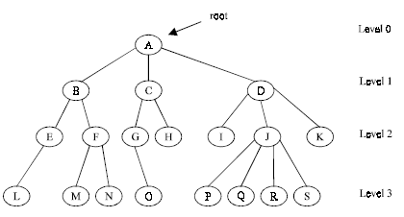
Basic Terminologies
Root is a specially designed node (or data items) in a tree
It is the first node in the hierarchical arrangement of the data items
Figure 1. A Tree

Slide 10
Tree Analogy
The hierarchical file structure in a computer system.
The root directory of a given device (designated with the backslash, as in C:\, on many systems) is the tree's root.
The directories one level below the root directory are its children.
Files represent leaves; they have no children of their own.

Slide 11
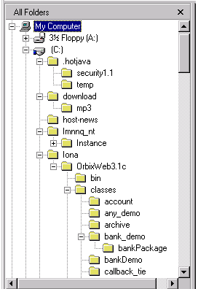
Tree Analogy: Examples
Examples of trees:
- Directory tree
- Family tree
- Company organization chart
- Table of contents
- etc.

Slide 12
Types of Binary Trees
Degenerate – only one child
Complete – always two children
Balanced – “mostly” two children
  more formal definitions exist, above are intuitive ideas
Degenerate binary tree
Balanced binary tree
Complete binary tree

Slide 13
Binary Trees complexity
Degenerate
  Height = O(n) for n nodes
  Similar to linked list
Balanced
  Height = O( log(n) ) for n nodes
  Useful for searches
Degenerate binary tree
Balanced binary tree

Slide 14
Binary Search complexity
finding a node depends on how many levels down it is situated.
Time of search
  Proportional to height of tree
  Balanced binary tree
    O( log(n) ) time
  Degenerate tree
    O( n ) time
    Like searching linked list / unsorted array

Slide 15
Binary Search Trees
Key property
  Value at node
    Smaller values in left subtree
    Larger values in right subtree
  Example
    X > Y
    X < Z
X
Y
Z

Slide 16
Binary Search Trees
Examples
5
10
10
2
45
5
30
5
45
30
2
25
45
2
25
30
10
25
Binary search trees
Not a binary search tree

Slide 17
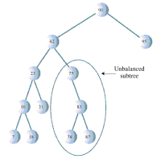
Unbalanced Trees
Unbalanced trees are those trees having most of their nodes on one side of the root or the other.
Trees become unbalanced because of the order in which the data items are inserted.

Slide 18
Why unbalanced trees occurred
If these key values are inserted randomly, the tree will be more or less balanced.
However, if an ascending sequence (like 11, 18, 33, 42, 65, and so on) or a descending sequence is generated, all the values will be right children (if ascending) or left children (if descending) and the tree will be unbalanced.
If a tree is created by data items whose key values arrive in random order, the problem of unbalanced trees may not be too much

Slide 19
Binary tree operations

Slide 20
Binary tree operations
binary-tree operations represented of
Finding or searching a node with a given key,
Inserting a new node
Traversing the tree
Deleting a node

Slide 21
Iterative Search of Binary Tree
Node *Find( Node *n, int key) {
while (n != NULL) {
if (n->data == key) // Found it
return n;
if (n->data > key) // In left subtree
n = n->left;
else // In right subtree
n = n->right;
}
return null;
}

Slide 22
Example Binary Searches with specified key
Finding a node with a specific key is the simplest of the major tree operations. Find ( root, 2 )
root
10
5
10 > 2, left
5 > 2, left
2 = 2, found
5 > 2, left
2 = 2, found
5
30
2
45
2
25
45
30
10
25

Slide 23
Example Binary Searches
Find (root, 25 )
10
5
10 < 25, right
30 > 25, left
25 = 25, found
5 < 25, right
45 > 25, left
30 > 25, left
10 < 25, right
25 = 25, found
5
30
2
45
2
25
45
30
10
25

Slide 24
Binary Search Tree Construction
How to build & maintain binary trees?
  Insertion
  Deletion
Maintain key property (invariant)
  Smaller values in left subtree
  Larger values in right subtree

Slide 25
Inserting a Node
To insert a node we must first find the place to insert it.
This is much the same process as trying to find a node as described in - Find Operation – section.
We follow the path from the root to the appropriate node, which will be the parent of the new node.
Once this parent is found, the new node is connected as its left or right child.
This depending on whether the new node's key is less than or greater than the parent.

Slide 26
Binary Search Tree – Insertion
Algorithm
  Perform search for value X
  Search will end at node Y (if X not in tree)
  If X < Y, insert new leaf X as new left subtree for Y
  If X > Y, insert new leaf X as new right subtree for Y
Observations
  O( log(n) ) operation for balanced tree
  Insertions may unbalance tree

Slide 27
Example Insertion
Insert ( 20 )
10
10 < 20, right
30 > 20, left
25 > 20, left
Insert 20 on left
5
30
2
25
45
20

Slide 28
Binary Search Tree – Deletion
Deleting a node is the most complicated common operation required for binary search trees.
However, deletion is important in many tree applications, and studying the details builds character.
finding the node you want to delete, using the same approach we saw in find() and insert().

Slide 29
Cont..
Once you've found the node, there are three cases to consider.
1. The node to be deleted is a leaf (has no
children).
2. The node to be deleted has one child.
3. The node to be deleted has two children.

Slide 30

Binary Search Tree – Deletion
Algorithm
  Perform search for value X
  If X is a leaf, delete X
  Else // must delete internal node
    a) Replace with largest value Y on left subtree
    OR smallest value Z on right subtree
    b) Delete replacement value (Y or Z) from subtree
Observation
  O( log(n) ) operation for balanced tree
  Deletions may unbalance tree

Slide 31
Example Deletion (Leaf)
Delete ( 25 )
10
10
10 < 25, right
30 > 25, left
25 = 25, delete
5
30
5
30
2
25
45
2
45

Slide 32
Example Deletion (Internal Node)
Delete ( 10 )
10
5
5
5
30
5
30
2
30
2
25
45
2
25
45
2
25
45
Replacing 10 with largest value in left subtree
Replacing 5 with largest value in left subtree
Deleting leaf

Slide 33
Example Deletion (Internal Node)
Delete ( 10 )
10
25
25
5
30
5
30
5
30
2
25
45
2
25
45
2
45
Replacing 10 with smallest value in right subtree
Deleting leaf
Resulting tree

Slide 34
Tree Traversal
Goal: visit every node of a tree
Traversing a tree means visiting each node in a specified order.
This process is not as commonly used as finding, inserting, and deleting nodes.
There are three simple ways to traverse a tree which are preorder, inorder, and postorder.
An inorder traversal of a binary search tree will cause all the nodes to be visited in ascending order, based on their key values.
Notes:
This method flow only three things:
1. Call itself to traverse the node's left subtree
2. Visit the node
3. Call itself to traverse the node's right subtree
Remember that visiting a node means doing something to it: displaying it, writing it to a file, or whatever.
Traversals work with any binary tree, not just with binary search trees.

Slide 35
Tree traversals
There are 3 common tree traversals.
1. in-order: left, root, right
2. pre-order: root, left, right
3. post-order: left, right, root
.
The traversal mechanism doesn't pay any attention to the key values of the nodes.
It only concerns itself with whether a node has children
Notes:
The traversal mechanism doesn't pay any attention to the key values of the nodes.
It only concerns itself with whether a node has children.

Slide 36

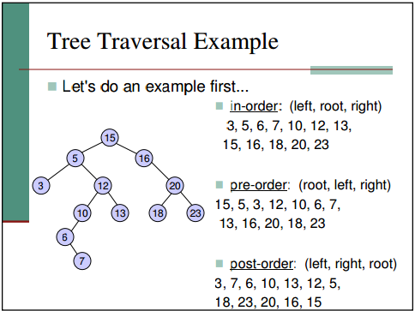
Tree Traversal Cont..

Slide 37
Finding Maximum and Minimum Values
find the maximum and minimum values in a binary search tree is so easy.
For the minimum, go to the left child of the root; then go to the left child of that child, and so on, until you come to a node that has no left child.
For the maximum, go to the right child of the root; then go to the right child of that child, and so on, until you come to a node that has no right child.

Slide 38
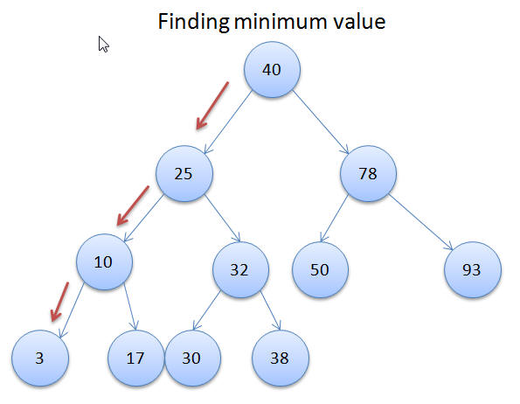
Example

